Slide 1
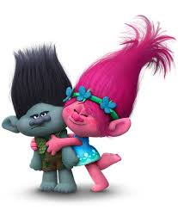
2 - 8 counts 1 - 8 count
Troll Dance
Click on rectangle to the right for music
“Can’t Stop the Feeling”
1.) Side-to-side Jumping Jacks
2.) Arms: Forward – Up – Forward – Up
3.) Whip and Wiggle
4.) Reach and Grab (alternate right then left)
5.) Head – Shoulders – Knees – Toes
Knees – Shoulders – Wing Flap (twice)
6.) Jump Rope
Notes:
- Get more out of it when exaggerate movements

