Slide 1
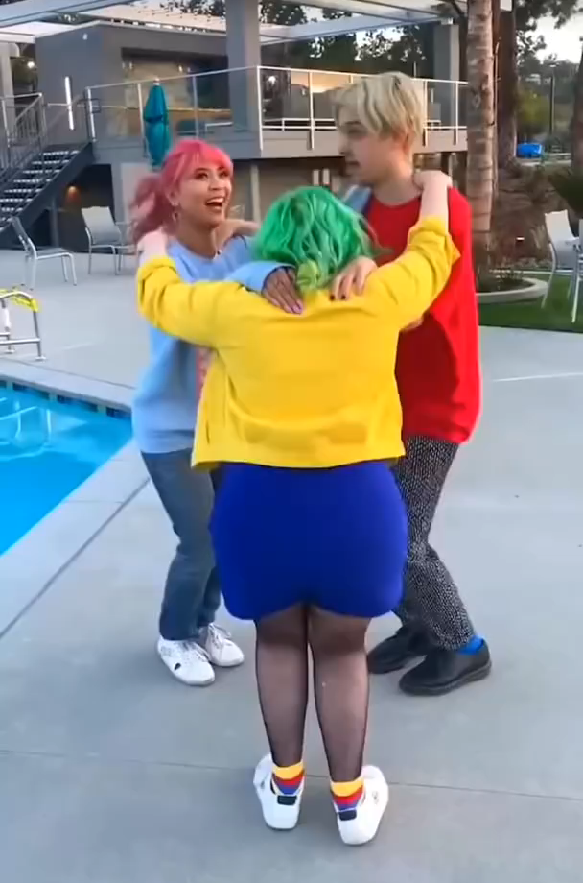
The Triangle Dance
____________________________
Standard 1:
Combines locomotor skills in cultural and/or creative dances (self and group) with correct rhythm.
Click on picture for video.
Focus in on one person to understand the pattern.

Slide 2

The Triangle Dance
____________________________
Forward
Left
Center
Right
All start in the center position
- one person starts right
- one person starts left
- one person starts forward
Always return to the center position before moving the next direction

