Slide 1
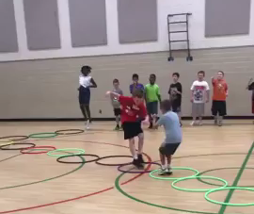
RPS Hoop Hop Showdown
Presented as found online
_____________________________
Comments:
This is NOT hopping, it is jumping!
The activity can be reconfigured so students are not standing in long lines!
Click on picture for the video
Notes:
Eric Branch – Lowell Elementary School, Indianapolis, IN – viral August, 2018

